Slide 1
RADx-UP Publication Tracking and Evaluation
RADx-UP Publications Network Analysis Brief (Articles identified through 03.15.2022)
Part 2
Data Analysis conducted by Jeffrey Smith, PhD
Presented by Josephine McKelvy, PhD 02.09.2023

Slide 2
Agenda
Approach
Methods
Results
Patterns of Scientific Collaboration (presented in Part 1)
Contents of Scientific Output
Key Takeaways & Next Steps
Notes:
In this presentation, I'll describe our approach and methods for analyzing the contents of scientific output (or publications).
Part 1 of these presentations focused on patterns of scientific collaboration (or co-authorship). Today, I’ll discuss the results, key takeaways & next steps of the contents of scientific output in this presentation.
1. Patterns of Scientific Collaboration
In the first section, T&E Team will describe the methods and results of the publication network analysis which allow for an understanding of the patterns of scientific collaboration among RADx-UP projects
2. Contents of Scientific Collaboration
In the second section, T&E Team will describe the methods and results of the publication network analysis which allow for an understanding of the contents of scientific collaboration among RADx-UP projects

Slide 3
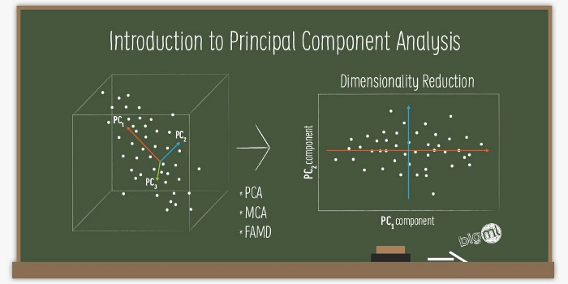
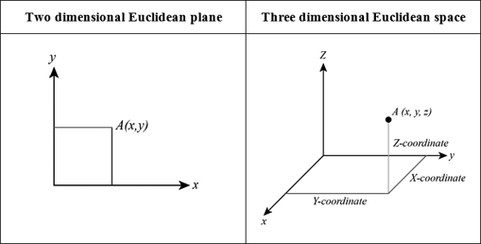
Approach: Multiple Correspondence Analysis (MCA)
Notes:
Our approach was to use Multiple Correspondence Analysis (or MCA) to explore the contents of RADx-UP publications, identified through mid-March 2022.
If you’re familiar with Principal Component Analysis (or PCA), you’d know that PCA reduces a large dataset to just a few intrinsic & meaningful components, dimensions, or features (with +/- correlation; 0=no correlation), based on (variance in) the dataset:
https://medium.com/analytics-vidhya/guide-to-principal-component-analysis-ab04a8a9c305
PCA + chi square-style contingency table of residuals (i.e., the difference between expected and observed values; or strength & direction of associations; or relative position of points)
=MCA (or two-mode network projection between topics and pubs?)
https://www.qualtrics.com/eng/correspondence-analysis-what-is-it-and-how-can-i-use-it-to-measure-my-brand-part-1-of-2/
https://www.qualtrics.com/eng/correspondence-analysis-what-is-it-and-how-can-i-use-it-to-measure-my-brand-part-2-of-2/
https://www.displayr.com/how-correspondence-analysis-works/
https://www.displayr.com/interpret-correspondence-analysis-plots-probably-isnt-way-think/
Likewise, Correspondence Analysis (or Multiple Correspondence Analysis for 3 or more variables) visualizes information from a table (like categorical variables in a cross-tab) to explore how those variables correspond with one another spatially, in 2-D
Variance explained by dimensions represents proportion of the information in the residuals (from the table that is included/summarized/displayed in plot)
+ Proximity=
how topics correspond to one another
how pubs correspond to one another
IF high variance explained, specifically normalized (which kinds of dots are closer to the origin?), and correct aspect ratio
Long distance from origin (0,0)=strong association &
acute angles (1-89 degrees)= positive association between topics and pubs
90 degrees=no association between topics and pubs
91-180 degrees=negative association between topics and pubs
+ Long distance from origin (0,0) also means that variable is distinct, different, discriminating, picky, separate from other variables
+ Short distance from origin (0,0) means that variable is common (or indistinct) in the dataset of current variables
+ Caveat: Compared to other variables in the table—thus NOT raw counts or absolute comparisons

Slide 4




Methods: Contents of Scientific Output
Data Collection & Curation
Data Extraction
Correspondence Analysis
Quality-controlled publications (n=70)
2 reviewers 1 arbiter
Explore how topics clustered
(collected as of 03.15.2022)
Notes:
So what were our methods?
First is data collection & curation. We gathered information in the quarterly publications tracking survey that we send out to RADx-UP project leads and from automated searches of RADx-UP grant numbers in PubMed and Scopus databases about scholarly products (like journal articles, conference papers, and grants). As of March 15, 2022, there were 76 RADx-UP publications. But we excluded 6 papers that did not focus on COVID-19 specifically, so our analytic dataset comprises 70 RADx-UP publications.
Next is data extraction where 2 reviewers independently categorized key information from publications, and a 3rd arbiter resolved any differences between these independent reviews. Internally, we know this as content analysis.
Finally, we used Multiple Correspondence Analysis to visualize how topics clustered together so that we can explore opportunities for collaboration within the consortium.

Slide 5






Methods: Topics
Study Target Population(s) (n=9 topics)
Study Setting (n=7 topics)
Urban/Rural Classification & Geographic Area (n=2 topics)
RADx-UP Publication
Study Design (n=6 topics)
Testing and Vaccine (n=17 topics) (Technology, Effectiveness, Psychosocial Factors)
Notes:
So what kinds of variables did we extract from the 70 RADx-UP publications? There were 43 topics total within these 5 buckets:
Underserved Target Population(s)
Study Site/Setting Served
Urban or Rural Classification
Study Design / Type of Analysis
Translational Science: COVID Vaccine / Testing & Community Engagement Strategies
[not sure where “peer influence” and “transportation” fit]

Slide 6
Contents of Scientific Output
Notes:
First, I’ll provide counts of our 43 topics. Then I will share the correspondence analysis of how those topics relate to one another.

Slide 7
Results: Fig. Topic Prevalence: RADx-UP Projects' Priority Populations
Notes:
The plot shows the number of articles that dealt with each population.
We see a diverse set of populations being the focus of articles. These categories are consistent with RADx-UP categories of communities served, but we see some subpopulations missing such as [Describe]
We see that subpopulations appear at different frequencies within the corpus.
[Update per analysis: Latinx – Hispanic appear in 7 articles (that is close to a third of the articles). Other racial, ethnic groups appeared less frequently. ]
Alaska Native
American Indian
Asian American
Black or African American
Children and adolescents (< 18 yo)
Hispanic or Latinx
Immigrants/refugees
Low socioeconomic status
Native Hawaiian
Older Adults
Pacific Islander
People experiencing homelessness
People who are incarcerated
People who use/inject drugs
Pregnant women
Rural
Sexual/gender minority
Other (specify)
NA (for non-applicable target population)
[Z articles did not focus on a specific subpopulation. ]

Slide 8
Results: Fig. 1 : Target Population(s)
Notes:
The graph on the left shows the number of publications that dealt with each target population. This graph does not sum up to 70 publications because some articles focused on anywhere from 2-8 target populations, as shown in the graph on the right. Only 20 of the 70 publications focused on 1 underserved population only.
These categories for target populations are consistent with the communities that RADx-UP projects serve, with Hispanic or Latino, African American, and youth being the most frequent in this set of publications.

Slide 9
Results: Fig. 2: Study Setting(s)
Notes:
This graph shows the number of publications that dealt with each setting served. This graph does not sum up to 70 publications because some articles didn’t clearly identify any setting.
The most common settings were:
School
Residential care facilities
Community health centers
Hospitals
Prison/jail
In-home
Other (please specify)
N/A (for non-applicable study site/setting)
[_ articles did not explicitly report a setting. ]

Slide 10
Results: Fig. 3: Study Design
Notes:
This graph shows the number of publications that used what type of study design or approach.
Publications used a diverse set of methods to collect and analyze data. This is important because research or writing team members can leverage different methodological skillsets across projects for meaningful collaborations on publications.

Slide 11

Results: Fig. 4: Translational Science Benefits Model
TSBM Benefit Categories
Clinical & Medical
Community & Public Health
Economic
Policy
Notes:
We also coded for the translational science benefits that each publication might have mentioned. This graph does not sum up to 70 publications because some articles identified multiple CTS benefits for testing (sum=77).
For example, these might include:
1) Clinical & Medical benefits in the form of (procedures, guidelines, tools)
2) Community & Public Health benefits in the form of (health activities, care, promotion)
3) Economic benefits in terms of (commercial products, patents, financial savings)
Or 4) Policy & Legislative benefits in the form of (advisory activities, organizational and public policies)
https://translationalsciencebenefits.wustl.edu/toolkit/toolkitfaqs/
This graph shows the number of publications that mentioned a variety of benefits for COVID-19 testing, color coded by sector or level.
Public health testing practices and testing delivery and uptake were the most frequent community and public health benefits in the 70 publications.

Slide 12

Results: Fig. 5: Translational Science Benefits Model
TSBM Benefit Categories
Clinical & Medical
Community & Public Health
Economic
Policy
Notes:
We also coded for the translational science benefits that each publication might have mentioned. For example, these might include:
Clinical & Medical benefits in the form of (procedures, guidelines, tools)
Community & Public Health benefits in the form of (health activities, care, promotion)
Economic benefits in terms of (commercial products, patents, financial savings)
Policy & Legislative benefits in the form of (advisory activities, organizational and public policies)
https://translationalsciencebenefits.wustl.edu/toolkit/toolkitfaqs/
This graph shows the number of publications that mentioned a variety of benefits for COVID-19 vaccination, color coded by sector or level.
Vaccine delivery and uptake and addressing vaccine hesitancy were the most frequent community and public health benefits in the 70 publications.
This graph does not sum up to 70 publications because some articles didn’t clearly identify any CTS benefits for vaccines (sum=61).

Slide 13
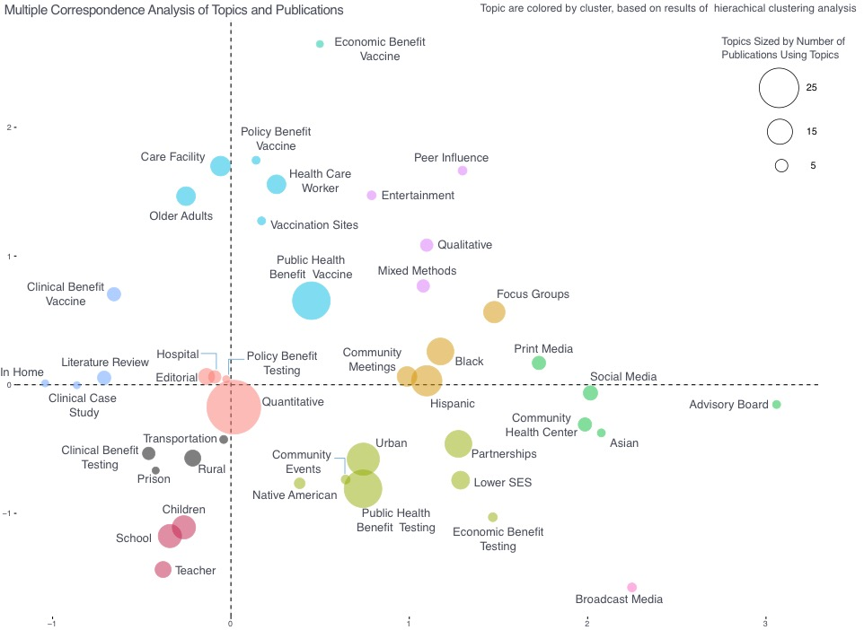
Results
Fig. 6: Multiple Correspondence Analysis of Topics and Publications
Notes:
Next, we conducted exploratory data analyses and assessed preliminary results with multiple correspondence analysis and hierarchical clustering analysis.
In this graph:
The 43 dots represent the columns in our cross-tab (or topics like: UPs, settings, rural/urban, study design, CTS benefits, and community engagement strategies), so close proximity means a stronger association, net of all the other variables. That is, papers tended to have these topics in common, if the dots are closer together.
Dots that are closer to the origin or center of this graph indicates topics that are common to many of the 70 publications in our dataset, while topics further out represent more distinctive or unique topics. So in this case, quantitative articles were very common while publications about advisory boards were unique.
[Axes]
The X axis, running left to right, represents a focus on clinical vs community engagement in the focus of the publication topic.
The Y axis, running top to bottom, represents vaccination vs testing uptake.
These 2 dimensions explain _% of the variance in our dataset, which means _.
The size of the dots represent how many publications were coded with that topic.
Small dots represent 5 pubs
Medium dots represent up to 15 pubs
Large dots represent up to 25 pubs
The color of the dots represent a cluster of topics, based on hierarchical clustering analysis
So cluster analysis helps us group a set of topics in such a way that topics in the same group (or cluster) are more similar (in some sense) to each other than to topics in other groups
Hierarchical cluster analysis helps us build a hierarchy, or arrangement of clusters with higher or lower statuses

Slide 14
Notes:
Next, we conducted exploratory data analyses and assessed preliminary results with multiple correspondence analysis and hierarchical clustering analysis.
In this graph:
The 43 dots represent the columns in our cross-tab (or topics like: UPs, settings, rural/urban, study design, CTS benefits, and community engagement strategies), so close proximity means a stronger association, net of all the other variables. That is, papers tended to have these topics in common, if the dots are closer together.
Dots that are closer to the origin or center of this graph indicates topics that are common to many of the 70 publications in our dataset, while topics further out represent more distinctive or unique topics. So in this case, quantitative articles were very common while publications about advisory boards were unique.
[Axes]
The X axis, running left to right, represents a focus on clinical vs community engagement in the focus of the publication topic.
The Y axis, running top to bottom, represents vaccination vs testing uptake.
These 2 dimensions explain _% of the variance in our dataset, which means _.
The size of the dots represent how many publications were coded with that topic.
Small dots represent 5 pubs
Medium dots represent up to 15 pubs
Large dots represent up to 25 pubs
The color of the dots represent a cluster of topics, based on hierarchical clustering analysis
So cluster analysis helps us group a set of topics in such a way that topics in the same group (or cluster) are more similar (in some sense) to each other than to topics in other groups
Hierarchical cluster analysis helps us build a hierarchy, or arrangement of clusters with higher or lower statuses

Slide 15


Notes:
We conducted exploratory data analyses and assessed preliminary results with multiple correspondence analysis and hierarchical clustering analysis.
In this graph:
The 43 dots represent the columns in our cross-tab (or topics like: UPs, settings, rural/urban, study design, CTS benefits, and community engagement strategies), so close proximity means a stronger association, net of all the other variables.
Dots that are closer to the origin or center of this graph indicates topics that are common to many of the 70 publications in our dataset, while topics further out represent more distinctive or unique topics.
Publications fell along 2 axes:
The X axis, running left to right, represents publications that focused on clinical vs community engagement topics.
The Y axis, running top to bottom, represents publications that focused on vaccination vs testing uptake.
[These 2 dimensions explain ~25% of the variance in our dataset, which means not a great fit, but the publication topics are quite heterogenous. JS: It took 5-8 dimensions to get over 50%, so it is a complicated data set to fit.]
The size of the dots represent how many publications were coded with that topic.
Small dots represent 5 pubs
Medium dots represent up to 15 pubs
Large dots represent up to 25 pubs
The color of the dots represent a cluster of topics, based on hierarchical clustering analysis
So cluster analysis helps us group a set of topics in such a way that topics in the same group (or cluster) are more similar (in some sense) to each other than to topics in other groups
Hierarchical cluster analysis helps us build a hierarchy, or arrangement of clusters with higher or lower statuses

Slide 16
Notes:
We conducted exploratory data analyses and assessed preliminary results with multiple correspondence analysis and hierarchical clustering analysis.
In this graph:
The 43 dots represent the columns in our cross-tab (or topics like: UPs, settings, rural/urban, study design, CTS benefits, and community engagement strategies), so close proximity means a stronger association, net of all the other variables.
Dots that are closer to the origin or center of this graph indicates topics that are common to many of the 70 publications in our dataset, while topics further out represent more distinctive or unique topics.
[Axes]
The X axis, running left to right, represents a focus on clinical vs community engagement in the focus of the publication topic.
The Y axis, running top to bottom, represents vaccination vs testing uptake.
These 2 dimensions explain _% of the variance in our dataset, which means _.
The size of the dots represent how many publications were coded with that topic. The legend is on the top, right corner, circled in orange:
Relatively small dots represent 5 pubs
Medium dots represent up to 15 pubs
Larger dots represent up to 25 pubs
The color of the dots represent a cluster of topics, based on hierarchical clustering analysis
So cluster analysis helps us group a set of topics in such a way that topics in the same group (or cluster) are more similar (in some sense) to each other than to topics in other groups
Hierarchical cluster analysis helps us build a hierarchy, or arrangement of clusters with higher or lower statuses

Slide 17
Notes:
We conducted exploratory data analyses and assessed preliminary results with multiple correspondence analysis and hierarchical clustering analysis.
In this graph:
The 43 dots represent the columns in our cross-tab (or topics like: UPs, settings, rural/urban, study design, CTS benefits, and community engagement strategies), so close proximity means a stronger association, net of all the other variables.
Dots that are closer to the origin or center of this graph indicates topics that are common to many of the 70 publications in our dataset, while topics further out represent more distinctive or unique topics.
[Axes]
The X axis, running left to right, represents a focus on clinical vs community engagement in the focus of the publication topic.
The Y axis, running top to bottom, represents vaccination vs testing uptake.
These 2 dimensions explain _% of the variance in our dataset, which means _.
The size of the dots represent how many publications were coded with that topic. The legend is on the top, right corner, circled in orange
Small dots represent 5 pubs
Medium dots represent up to 15 pubs
Large dots represent up to 25 pubs
The color of the dots represent a cluster of topics, based on hierarchical clustering analysis
So cluster analysis helps us group a set of topics in such a way that topics in the same group (or cluster) are more similar (in some sense) to each other than to topics in other colored groups
[Hierarchical cluster analysis helps us build an arrangement of clusters with higher or lower statuses]

Slide 18
Notes:
These preliminary results show different pockets where different topics tend to cluster together such as:
A) School Studies, circled in orange on the bottom left corner
Those magenta dots represent publications focusing on: School setting, Children, Teachers
B) Care Facility Studies
Cerulean, quadrant 1 & 2
C) Engagement with underserved populations
Tan, quadrant 1
Olive, quadrant 4
Green, quadrant 4
Salmon: Policy benefit of testing in quantitative or editorial publications in hospital settings—most common types of pubs
Gray: Clinical benefit of testing, transportation, among rural UP in prison settings
Periwinkle: Clinical benefit of vaccine, clinical case study or lit review of in-home
B) Cerulean: public health & policy benefits of vaccines among older adults, health care workers at vaccination sites, care facilities
Lavender: peer influence and entertainment (as community engagement?) in qualitative or mixed methods studies
C) Tan: focus groups and community meetings to engage Black and Hispanic UPs
C) Olive: public health & economic benefits of testing, using community events and partnerships to engage UPs who are urban, indigenous, or lower SES
A) Magenta: School setting, UPs: Children, Teacher
C) Green: Economic benefits of vaccines, using print media, social media, or advisory boards to engage Asian UPs at Community Health Centers
Light pink: broadcast media as community engagement

Slide 19
Notes:
These preliminary results show different pockets where different topics tend to cluster together such as:
A) School Studies
Magenta, quadrant 3
B) Care Facility Studies
Cerulean dots represent public health & policy, economic benefits of vaccines among older adults, health care workers at vaccination sites, care facilities
C) Engagement with underserved populations
Tan, quadrant 1
Olive, quadrant 4
Green, quadrant 4
Salmon: Policy benefit of testing in quantitative or editorial publications in hospital settings—most common types of pubs
Gray: Clinical benefit of testing, transportation, among rural UP in prison settings
Periwinkle: Clinical benefit of vaccine, clinical case study or lit review of in-home
B) Cerulean: public health & policy benefits of vaccines among older adults, health care workers at vaccination sites, care facilities
Lavender: peer influence and entertainment (as community engagement?) in qualitative or mixed methods studies
C) Tan: focus groups and community meetings to engage Black and Hispanic UPs
C) Olive: public health & economic benefits of testing, using community events and partnerships to engage UPs who are urban, indigenous, or lower SES
A) Magenta: School setting, UPs: Children, Teacher
C) Green: Economic benefits of vaccines, using print media, social media, or advisory boards to engage Asian UPs at Community Health Centers
Light pink: broadcast media as community engagement

Slide 20
Notes:
These preliminary results show different pockets where different topics tend to cluster together such as:
A) School Studies
Magenta, quadrant 3
B) Care Facility Studies
Cerulean, quadrant 1 & 2
C) Publications that use Community Engagement strategies with underserved populations
Tan: focus groups and community meetings to engage Black and Hispanic UPs
Olive: public health & economic benefits of testing, using community events and partnerships to engage UPs who are urban, indigenous, or lower SES
Green: Economic benefits of vaccines, using print media, social media, or advisory boards to engage Asian UPs at Community Health Centers
Salmon: Policy benefit of testing in quantitative or editorial publications in hospital settings—most common types of pubs
Gray: Clinical benefit of testing, transportation, among rural UP in prison settings
Periwinkle: Clinical benefit of vaccine, clinical case study or lit review of in-home
B) Cerulean: public health & policy benefits of vaccines among older adults, health care workers at vaccination sites, care facilities
Lavender: peer influence and entertainment (as community engagement?) in qualitative or mixed methods studies
C) Tan: focus groups and community meetings to engage Black and Hispanic UPs
C) Olive: public health & economic benefits of testing, using community events and partnerships to engage UPs who are urban, indigenous, or lower SES
A) Magenta: School setting, UPs: Children, Teacher
C) Green: Economic benefits of vaccines, using print media, social media, or advisory boards to engage Asian UPs at Community Health Centers
Light pink: broadcast media as community engagement

Slide 21

Key Takeaways: Contents of Scientific Output
substantive topics
underserved populations
multiple settings
methods
complementing skills & resources
Publications Dashboard
Notes:
So what are some key takeaways from this exploratory analysis?
RADx-UP publications study a variety of substantive topics and underserved populations in multiple settings, using a wide set of methods.
These topics include racial and ethnic minorities, at-risk populations, and COVID-related topics that are consistent with the goals of RADx-UP.
The observed diversity in approaches and topics of study also represents an opportunity to bring together teams with complementing skills and resources.
The publications dashboard is a great tool for stakeholders to identify knowledge gaps and potential opportunities for collaboration.

Slide 22
Recommendations – Content of RADx-UP Publications
underserved populations
people with lower socioeconomic status (SES)
healthcare workers
combinations
(e.g., lower SES, peer influence, and policy benefits of vaccine uptake)
publications dashboard
Notes:
RADx-UP could measure its impact on novel underserved populations this analysis identified, such as people with lower SES populations and healthcare workers.
Researchers could identify possible future studies in the underexplored parts of that graph, like novel combinations of location, population and engagement (e.g., Lower SES, peer influence and policy benefits of vaccine uptake)
Stakeholders could also use the publications dashboard to identify knowledge gaps and potential opportunities for collaboration.

Slide 23
Next Steps: Analyses
Network Analysis
Content Analysis
Findings of RADx-UP publications
Relationships between RADx-UP publication authors and topics
Bibliometric Analysis
Research impact of RADx-UP publications through citation counts and indices
Bibliometric Analysis and Content Analysis identify the most significant findings from RADx-UP.
Content Analysis and Network Analysis identify relationships among project design, methodologies, and findings.
Bibliometric Analysis and Network Analysis identify connectivity of RADx-UP publications.
Notes:
What are our next steps?
T&E will continue to evaluate RADx-UP publications data through: Network Analysis (like the one we presented 2 weeks ago), Content Analysis, and Bibliometrics Analysis to synthesize key findings and encourage project collaboration.

Slide 24
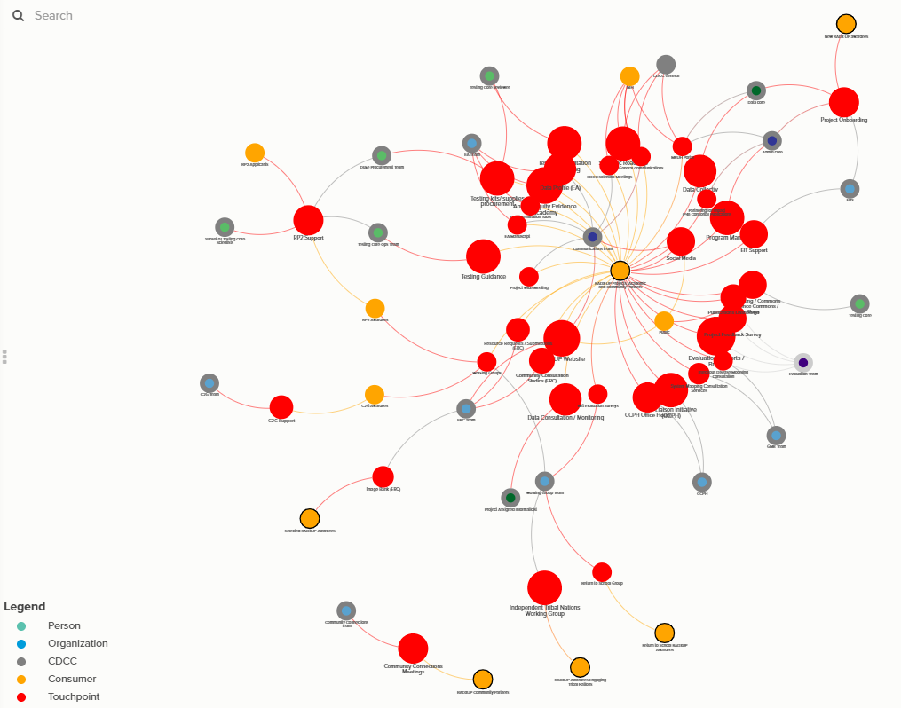
Next Steps: Dissemination
Group Model Building
Work Groups
Evidence Academy
Partnering for Impact (P4I)
Communications
Notes:
T&E will also disseminate findings and work with other RADx-UP teams to use findings to support:
Group Model Building
Work Groups
Evidence Academy
Partnering for Impact
Communications team
in their work to increase scholarly output, particularly with co-authors from underserved communities or community-serving organizations.

Slide 25
Notes:
That concludes our presentation. Thank you!

Slide 26
Citations for Articles Included in the Publication Analysis
Bardenheier B.H., Gravenstein S., Blackman C., Gutman R., Sarkar I.N., Feifer R.A., White E.M., McConeghy K., Nanda A., Mor V. Adverse events following mRNA SARS-CoV-2 vaccination among U.S. nursing home residents. Vaccine. 2021; 39(29):3844-3851. doi: 10.1016/j.vaccine.2021.05.088
C., Zhang K., Lee M., Fisher-Hoch S., Guajardo E., McCormick J., de la Cerda I., Fernandez M.E., Reininger B. Census tract patterns and contextual social determinants of health associated with COVID-19 in a Hispanic population from South Texas: A spatiotemporal perspective. JMIR Publ. Heal. Surveil. 2021; 7(8):e29205. doi: 10.2196/29205
Baum M.K., Tamargo J.A., Diaz-Martinez J., Delgado-Enciso I., Meade C.S., Kirk G.D., Mehta S.H., Moore R., Kipke M.D., Shoptaw S.J., Mustanski B., Mandler R.N., Khalsa J.H., Siminski S., Javanbakht M., Gorbach P.M. HIV, psychological resilience, and substance misuse during the COVID-19 pandemic: A multi-cohort study. Drug Alcohol Depend. 2022; 231:109230. doi: 10.1016/j.drugalcdep.2021.109230
Begay M., Kakol M., Sood A., Upson D. Strengthening digital health technology capacity in Navajo communities to help counter the COVID-19 pandemic. Ann. Am. Thorac. Soc. 2021; 18(7):1109-1114. doi: 10.1513/AnnalsATS.202009-1136PS
Berry S.D., Baier R.R., Syme M., Gouskova N., Bishnoi C., Patel U., Leitson M., Gharpure R., Stone N.D., Link-Gelles R., Gifford D.R. Strategies associated with COVID-19 vaccine coverage among nursing home staff. J. Am. Geriatr. Soc. 2022; 70(1):19-28. doi: 10.1111/jgs.17559
Berry S.D., Johnson K.S., Myles L., Herndon L., Montoya A., Fashaw S., Gifford D. Lessons learned from frontline skilled nursing facility staff regarding COVID-19 vaccine hesitancy. J. Am. Geriatr. Soc. 2021; 69(5):1140-1146. doi: 10.1111/jgs.17136
Bien-Gund C., Dugosh K., Acri T., Brady K., Thirumurthy H., Fishman J., Gross R. Factors associated with US public motivation to use and distribute COVID-19 self-tests. JAMA Netw. Open. 2021; 4(1):e2034001. doi: 10.1001/jamanetworkopen.2020.34001
Bien-Gund C.H., Shah J., Ho J.I., Stephens-Shields A., Shea K., Fishman J., Thirumurthy H., Acri T., Dugosh K., Gross R. The COVID-19 Self-Testing through Rapid Network Distribution (C-STRAND) trial: A randomized controlled trial to increase COVID-19 testing in underserved populations. Contemp. Clin. Trials. 2021; 110:106585. doi: 10.1016/j.cct.2021.106585
Bigelow B.F., Saxton R.E., Flores-Miller A., Mostafa H.H., Loss M.J., Phillips K.H., Moore A.M., Hale W.D., Tolson T.M., McCann N.S., Catlett C.L., Golden S.H., Clark J.M., Page K.R. Community testing and SARS-CoV-2 rates for Latinxs in Baltimore. Am. J. Prev. Med. 2021; 60(6):e281-e286. doi: 10.1016/j.amepre.2021.01.005
Boutzoukas A.E., Zimmerman K.O., Benjamin D.K., Chick K.J., Curtiss J., Høeg T.B. Quarantine elimination for K-12 students with mask-on-mask exposure to SARS-CoV-2. Pediatrics. 2022; 149:e2021054268L. doi: 10.1542/peds.2021-054268L
Boutzoukas A.E., Zimmerman K.O., Benjamin D.K., Jr. School safety, masking, and the delta variant. Pediatrics. 2022: e2021054396. doi: 10.1542/peds.2021-054396
Boutzoukas A.E., Zimmerman K.O., Benjamin D.K., Jr., DeMuri G.P., Kalu I.C., Smith M.J., McGann K.A., Koval S., Brookhart M.A. Secondary transmission of COVID-19 in K-12 schools: Findings from two states. Pediatrics. 2022; 149:e2021054268K. doi: 10.1542/PEDS.2021-054268K
Boutzoukas A.E., Zimmerman K.O., Mann T.K., Moorthy G.S., Blakemore A., McGann K.A., Smith M.J., Nutting B., Kerley K., Brookhart M.A., Edwards L., Rak Z., Benjamin D.K., Jr. A school-based SARS-CoV-2 testing program: Testing uptake and quarantine length after in-school exposures. Pediatrics. 2022; 149:e2021054268J. doi: 10.1542/PEDS.2021-054268J
Canaday D.H., Carias L., Oyebanji O.A., Keresztesy D., Wilk D., Payne M., Aung H., St. Denis K., Lam E.C., Rowley C.F., Berry S.D., Cameron C.M., Cameron M.J., Wilson B., Balazs A.B., Gravenstein S., King C.L. Reduced BNT162b2 mRNA vaccine response in SARS-CoV-2-naive nursing home residents. Clin. Infect. Dis. 2021; 73(11):2112-2115. doi: 10.1093/cid/ciab447
Ciccone E.J., Conserve D.F., Dave G., Hornik C.P., Kuhn M.L., Herling J.L., Song M., Alston S., Singler L., Schmidt M.D., Jones A., Broderick S., Wruck L.M., Kibbe W.A., Aiello A.E., Woods C.W., Richmond A., Cohen-Wolkowiez M., Corbie-Smith G. At-home testing to mitigate community transmission of SARS-CoV-2: Protocol for a public health intervention with a nested prospective cohort study. BMC Public Health. 2021; 21(1):2209. doi: 10.1186/s12889-021-12007-w
D’Agostino E.M., Haroz E.E., Linde S., Layer M., Green M., Ko L.K. School-academic partnerships in support of safe return to schools during the COVID-19 pandemic. Pediatrics. 2022; 149:e2021054268C. doi: 10.1542/PEDS.2021-054268C
Diaz-Martinez J., Tamargo J.A., Delgado-Enciso I., Liu Q., Acuña L., Laverde E., Barbieri M.A., Trepka M.J., Campa A., Siminski S., Gorbach P.M., Baum M.K. Resilience, anxiety, stress, and substance use patterns during COVID-19 pandemic in the Miami Adult Studies on HIV (MASH) cohort. AIDS Behav. 2021; 25(11):3658-3668. doi: 10.1007/s10461-021-03292-y
Feifer R.A., Bethea L., White E.M. Racial disparities in COVID-19 vaccine acceptance: Building trust to protect nursing home staff and residents. J. Am. Med. Dir. Assoc. 2021; 22(9):1853-1855.e1. doi: 10.1016/j.jamda.2021.07.006

Slide 27
Citations for Articles Included in the Publication Analysis
Fujimoto A.B., Keskinocak P., Yildirim I. Significance of SARS-CoV-2 specific antibody testing during COVID-19 vaccine allocation. Vaccine. 2021; 39(35):5055-5063. doi: 10.1016/j.vaccine.2021.06.067
Goldman J.L., Schuster J.E., Maier V.F., Anand R., Hill E.E., Butteris S.M., DeMuri G.P., Omidfar S.A., Brookhart M.A., Pak J., Benjamin D.K., Jr., Zimmerman K.O. Urban classification, not COVID-19 community rates, was associated with modes of learning in US K-12 schools. Pediatrics. 2022; 149:e2021054268M. doi: 10.1542/PEDS.2021-054268M
Guilamo-Ramos V., Thimm-Kaiser M., Benzekri A., Hidalgo A., Lanier Y., Tlou S., de Lourdes Rosas López M., Soletti A.B., Hagan H. Nurses at the frontline of public health emergency preparedness and response: Lessons learned from the HIV/AIDS pandemic and emerging infectious disease outbreaks. Lancet Infect. Dis. 2021. doi: 10.1016/S1473-3099(20)30983-X
Hallgren E., Moore R., Purvis R.S., Hall S., Willis D.E., Reece S., CarlLee S., Gurel-Headley M., McElfish P.A. Facilitators to vaccination among hesitant adopters. Hum. Vaccines Immunother. 2021; 17(12):5168-5175. doi: 10.1080/21645515.2021.2010427
Hammitt L.L., Vigil D.E., Reid R. Tribal sovereignty in research and community engagement for a COVID-19 vaccine clinical trial on the Navajo Nation: Beyond a Facebook town hall. Am. J. Public Health. 2021; 111(8):1431-1432. doi: 10.2105/AJPH.2021.306400
Haroz E.E., Kalb L.G., Newland J.G., Goldman J.L., Mast D.K., Ko L., Grass R., Shah P., Walsh T., Schuster J.E. Implementation of school-based COVID-19 testing programs in underserved populations. Pediatrics. 2022; 149:e2021054268G. doi: 10.1542/peds.2021-054268G
Harrison J., Berry S., Mor V., Gifford D. “Somebody like me”: Understanding COVID-19 vaccine hesitancy among staff in skilled nursing facilities. J. Am. Med. Dir. Assoc. 2021; 22(6):1133-1137. doi: 10.1016/j.jamda.2021.03.012
Hendricks B., Paul R., Smith C., Wen S., Kimble W., Amjad A., Atkins A., Hodder S. Coronavirus testing disparities associated with community level deprivation, racial inequalities, and food insecurity in West Virginia. Ann. Epidemiol. 2021; 59:44-49. doi: 10.1016/j.annepidem.2021.03.009
Horton D.B., Barrett E.S., Roy J., Gennaro M.L., Andrews T., Greenberg P., Bruiners N., Datta P., Ukey R., Velusamy S.K., Fine D., Honnen W.J., Yin Y.S., Pinter A., Brooks A., Tischfield J., Hussain S., Jagpal S., Swaminathan S., Parmar V., Reilly N., Gaur S., Panettieri R.A., Carson J.L., Blaser M.J. Determinants and dynamics of SARS-CoV-2 infection in a diverse population: 6-month evaluation of a prospective cohort study. J. Infect. Dis. 2021; 224(8):1345-1356. doi: 10.1093/infdis/jiab411
Hotez P.J., Narayan K.M.V. Restoring vaccine diplomacy. JAMA. 2021; 325(23):2337-2338. doi: 10.1001/jama.2021.7439
Huang X., Tang G., Ismail N., Wang X. Developing RT-LAMP assays for rapid diagnosis of SARS-CoV-2 in saliva. EBioMedicine. 2022; 75:103736. doi: 10.1016/j.ebiom.2021.103736
Jimenez M.E., Rivera-Núñez Z., Crabtree B.F., Hill D., Pellerano M.B., Devance D., Macenat M., Lima D., Martinez Alcaraz E., Ferrante J.M., Barrett E.S., Blaser M.J., Panettieri R.A., Jr. Black and Latinx community perspectives on COVID-19 mitigation behaviors, testing, and vaccines. JAMA Netw. Open. 2021; 4(7):e2117074. doi: 10.1001/jamanetworkopen.2021.17074
Kerkhoff A.D., Farrand E., Marquez C., Cattamanchi A., Handley M.A. Addressing health disparities through implementation science—a need to integrate an equity lens from the outset. Implement. Sci. 2022; 17(1):13. doi: 10.1186/s13012-022-01189-5
Klonoff D.C., Messler J., Valk T., Jagannathan R., Pasquel F.J., Umpierrez G.E. Clinical trials of COVID-19 therapies should account for diabetes and hyperglycemia. J. Diabetes Sci. Technol. 2021; 15(5):1181-1187. doi: 10.1177/19322968211013369
Klonoff D.C., Messler J.C., Umpierrez G.E., Peng L., Booth R., Crowe J., Garrett V., McFarland R., Pasquel F.J. Association between achieving inpatient glycemic control and clinical outcomes in hospitalized patients with COVID-19: A multicenter, retrospective hospital-based analysis. Diabetes Care. 2021; 44(2):578-585. doi: 10.2337/dc20-1857
Konetzka R.T., White E.M., Pralea A., Grabowski D.C., Mor V. A systematic review of long-term care facility characteristics associated with COVID-19 outcomes. J. Am. Geriatr. Soc. 2021; 69(10):2766-2777. doi: 10.1111/jgs.17434
Malloy G.S.P., Puglisi L., Brandeau M.L., Harvey T.D., Wang E.A. Effectiveness of interventions to reduce COVID-19 transmission in a large urban jail: A model-based analysis. BMJ Open. 2021; 11(2):e042898. doi: 10.1136/bmjopen-2020-042898
Martinez D.A., Klein E.Y., Parent C., Prieto D., Bigelow B.F., Saxton R.E., Page K.R. Latino household transmission of SARS-CoV-2. Clin. Infect. Dis. 2022; 74(9):1675-1677. doi: 10.1093/cid/ciab753
Martinez M.E., Nodora J.N., McDaniels-Davidson C., Crespo N.C., Edward A.A. Equitable COVID-19 vaccination for Hispanics in the United States: A success story from California border communities. Int. J. Environ. Res. Public Health. 2022; 19(1):535. doi: 10.3390/ijerph19010535
Martinez S.S., Huang Y., Acuna L., Laverde E., Trujillo D., Barbieri M.A., Tamargo J., Campa A., Baum M.K. Role of selenium in viral infections with a major focus on SARS-CoV-2. Int. J. Mol. Sci. 2022; 23(1):280. doi: 10.3390/ijms23010280

Slide 28
Citations for Articles Included in the Publication Analysis
McDonnell E.P., Altomare N.J., Parekh Y.H., Gowda R.C., Parikh P.D., Lazar M.H., Blaser M.J. COVID-19 as a trigger of recurrent Guillain–Barré syndrome. Pathogens. 2020; 9(11):965. doi: 10.3390/pathogens9110965
McElfish P.A., Willis D.E., Shah S.K., Reece S., Andersen J.A., Schootman M., Richard-Davis G., Selig J.P., Warmack T.S. Parents’ and guardians’ intentions to vaccinate children against COVID-19. Vaccines. 2022; 10(3):361. doi: 10.3390/vaccines10030361
Michita R.T., Mysorekar I.U. Golden Syrian hamsters as a model for revisiting the role of biological sex differences in SARS-CoV-2 infection. mBio. 2021; 12(6):e0184821. doi: 10.1128/mBio.01848-21
Moorthy G.S., Mann T.K., Boutzoukas A.E., Blakemore A., Alan Brookhart M., Edwards L., Jackman J.G., Maradiaga Panayotti G.M., Warren T., Pendleton J., Garces A.W., Corneli A., Weber D.J., Kalu I.C., Benjamin D.K., Zimmerman K.O. Masking adherence in K-12 schools and SARS-CoV-2 secondary transmission. Pediatrics. 2022; 149:e2021054268l. doi: 10.1542/PEDS.2021-054268I
Mor V., Gutman R., Yang X., White E.M., McConeghy K.W., Feifer R.A., Blackman C.R., Kosar C.M., Bardenheier B.H., Gravenstein S.A. Short-term impact of nursing home SARS-CoV-2 vaccinations on new infections, hospitalizations, and deaths. J. Am. Geriatr. Soc. 2021; 69(8):2063-2069. doi: 10.1111/jgs.17176
Niznik J.D., Harrison J., White E.M., Syme M., Hanson L.C., Kelley C.J., Porter L., Berry S.D. Perceptions of COVID-19 vaccines among healthcare assistants: A national survey. J. Am. Geriatr. Soc. 2022; 70(1):8-18. doi: 10.1111/jgs.17437
Oyebanji O.A., Wilson B., Keresztesy D., Carias L., Wilk D., Payne M., Aung H., Denis K.S., Lam E.C., Rowley C.F., Berry S.D., Cameron C.M., Cameron M.J., Schmader K.E., Balazs A.B., King C.L., Canaday D.H., Gravenstein S. Does a lack of vaccine side effects correlate with reduced BNT162b2 mRNA vaccine response among healthcare workers and nursing home residents? Aging Clin. Exp. Res. 2021; 33(11):3151-3160. doi: 10.1007/s40520-021-01987-9
Peart Akindele N., Kouo T., Karaba A.H., Gordon O., Fenstermacher K.Z.J., Beaudry J., Rubens J.H., Atik C.C., Zhou W., Ji H., Tao X., Vaidya D., Mostafa H., Caturegli P., Blair P.W., Sauer L., Cox A.L., Persaud D. Distinct cytokine and chemokine dysregulation in hospitalized children with acute coronavirus disease 2019 and multisystem inflammatory syndrome with similar levels of nasopharyngeal severe acute respiratory syndrome coronavirus 2 shedding. J. Infect. Dis. 2021; 224(4):606-615. doi: 10.1093/infdis/jiab285
Pirraglia P.A., Torres C.H., Collins J., Garb J., Kent M., McAdoo S.P., Oloruntola-Coates Y., Smith J.M., Thomas A. COVID-19 mitigation for high-risk populations in Springfield Massachusetts USA: A health systems approach. Int. J. Equity Health. 2021; 20(1):230. doi: 10.1186/s12939-021-01567-3
Price B.S., Khodaverdi M., Halasz A., Hendricks B., Kimble W., Smith G.S., Hodder S.L. Predicting increases in COVID-19 incidence to identify locations for targeted testing in West Virginia: A machine learning enhanced approach. PLoS ONE. 2021; 16(11):e0259538. doi: 10.1371/journal.pone.0259538
Purvis R.S., Hallgren E., Moore R.A., Willis D.E., Hall S., Gurel-Headley M., McElfish P.A. Trusted sources of COVID-19 vaccine information among hesitant adopters in the United States. Vaccines. 2021; 9(12):1418. doi: 10.3390/vaccines9121418
Rivera-Núñez Z., Jimenez M.E., Crabtree B.F., Hill D., Pellerano M.B., Devance D., Macenat M., Lima D., Gordon M., Sullivan B., Rosati R.J., Ferrante J.M., Barrett E.S., Blaser M.J., Panettieri R.A., Hudson S.V. Experiences of Black and Latinx health care workers in support roles during the COVID-19 pandemic: A qualitative study. PLoS ONE. 2022; 17(1):e0262606. doi: 10.1371/journal.pone.0262606
Saw A., Yi S.S., Ðoàn L.N., Tsoh J.Y., Yellow Horse A.J., Kwon S.C., Samoa R., Aitaoto N., Takeuchi D.T. Improving Asian American health during the syndemic of COVID-19 and racism. eClinicalMedicine. 2022; 45:101313. doi: 10.1016/j.eclinm.2022.101313
Sherby M.R., Kalb L.G., Coller R.J., DeMuri G.P., Butteris S., Foxe J.J., Zand M.S., Freedman E.G., Dewhurst S., Newland J.G., Gurnett C.A. Supporting COVID-19 school safety for children with disabilities and medical complexity. Pediatrics. 2022; 149:e2021054268H. doi: 10.1542/PEDS.2021-054268H
Sherby M.R., Walsh T.J., Lai A.M., Neidich J.A., Balls-Berry J.E., Morris S.M., Head R., Prener C.G., Newland J.G., Gurnett C.A., Baldenweck M., Bono K., Brodsky V.B., Caburnay C.A., Constantino J.N., Dougherty N.L., Dubois J.M., Fritz S.A., Gotto G.S., Imbeah A., Kalb L.G., Liu J., Maricque B.B., McKay V.R., Myers L.S., Poor T.J., Powell B.J., Mueller N.B., Schlaggar B.L., Schmidt A., Snider E., Traughber M.C., van Stone M., Vestal L., Wilcher-Roberts M. SARS-CoV-2 screening testing in schools for children with intellectual and developmental disabilities. J. Neurodevelopmental Disord. 2021; 13(1):31. doi: 10.1186/s11689-021-09376-z
Stadnick N.A., Cain K.L., Oswald W., Watson P., Ibarra M., Lagoc R., Ayers L.O., Salgin L., Broyles S.L., Laurent L.C., Pezzoli K., Rabin B. Co-creating a theory of change to advance COVID-19 testing and vaccine uptake in underserved communities. Health Serv. Res. 2022; 57:149-157. doi: 10.1111/1475-6773.13910
Strathdee S.A., Abramovitz D., Harvey-Vera A., Vera C.F., Rangel G., Artamonova I., Chaillon A., Ignacio C., Calderon A., Martin N.K., Patterson T.L. Prevalence and correlates of SARS-CoV-2 seropositivity among people who inject drugs in the San Diego-Tijuana border region. PLoS ONE. 2021; 16(11):e0260286. doi: 10.1371/journal.pone.0260286

Slide 29
Citations for Articles Included in the Publication Analysis
Strathdee SA, Abramovitz D, Harvey-Vera A, Vera CF, Rangel G, Artamonova I, Patterson TL, Mitchell RA, Bazzi AR. Correlates of Coronavirus Disease 2019 (COVID-19) vaccine hesitancy among people who inject drugs in the San Diego-Tijuana border region. Clin. Infect. Dis. 2021: ciab975. doi: 10.1093/cid/ciab975
Tamargo J.A., Martin H.R., Diaz-Martinez J., Trepka M.J., Delgado-Enciso I., Johnson A., Mandler R.N., Siminski S., Gorbach P.M., Baum M.K. COVID-19 testing and the impact of the pandemic on the Miami Adult Studies on HIV cohort. J Acquir Immune Defic Syndr. 2021; 87(4):1016-1023. doi: 10.1097/QAI.0000000000002680
Thakkar P.V., Zimmerman K.O., Benjamin D.K., Jr. SARS-CoV-2 infections and incidence at a North Carolina pre-kindergarten-12 school during in-person education: August 2020 to January 2021. J. Sch. Health. 2022; 92(5):461-468. doi: 10.1111/josh.13148
Tsai W.-Y., Ching L.L., Hsieh S.-C., Melish M.E., Nerurkar V.R., Wang W.-K. A real-time and high-throughput neutralization test based on SARS-CoV-2 pseudovirus containing monomeric infrared fluorescent protein as reporter. Emerg. Microbes Infect. 2021; 10(1):894-904. doi: 10.1080/22221751.2021.1925163
Vashist K., Akintobi T., Bednarczyk R.A., Narayan K.M.V., Patel S.A. Demographic benchmarks for equitable coverage of COVID-19 vaccination. Am. J. Prev. Med. 2021; 61(2):291-293. doi: 10.1016/j.amepre.2021.04.001
Vashist K., Choi D., Patel S.A. Identification of groups at high risk for under-coverage of seasonal influenza vaccination: A national study to inform vaccination priorities during the COVID-19 pandemic. Ann. Epidemiol. 2022; 68:16-23. doi: 10.1016/j.annepidem.2021.12.008
Verma S., Joshi C.S., Silverstein R.B., He M., Carter E.B., Mysorekar I.U. SARS-CoV-2 colonization of maternal and fetal cells of the human placenta promotes alteration of local renin-angiotensin system. Med. 2021; 2(5):575-590.e5. doi: 10.1016/j.medj.2021.04.009
Wang S.X., Bell-Rogers N., Dillard D., Harrington M.A. COVID-19 vaccine hesitancy in Delaware’s underserved communities. Delaware J. Public Health. 2021; 7(4):168-175. doi: 10.32481/djph.2021.09.022
Warrier A, Sood A. Home-based physiological monitoring of patients with COVID-19. Southwest J. Pulm. Crit. Care. 2021; 23(3):76-88. doi: 10.13175/swjpcc005-21
White E.M., Yang X., Blackman C., Feifer R.A., Gravenstein S., Mor V. Incident SARS-CoV-2 infection among mRNA-vaccinated and unvaccinated nursing home residents. New Engl. J. Med. 2021; 385(5):474-476. doi: 10.1056/NEJMc2104849
Williams N., Tutrow H., Pina P., Belli H.M., Ogedegbe G., Schoenthaler A. Assessment of racial and ethnic disparities in access to COVID-19 vaccination sites in Brooklyn, New York. JAMA Netw. Open. 2021; 4(6):e2113937. doi: 10.1001/jamanetworkopen.2021.13937
Zimmerman K.O., Brookhart M.A., Kalu I.C., Boutzoukas A.E., McGann K.A., Smith M.J., Panayotti G.M.M., Armstrong S.C., Weber D.J., Moorthy G.S., Benjamin D.K., Jr. Community SARS-CoV-2 surge and within-school transmission. Pediatrics. 2021; 148(4):e2021052686. doi: 10.1542/peds.2021-052686
Zimmerman K.O., Goldman J.L., Schuster J.E., Mena A., Quiriconi M., Butteris S.M., Koval S., DeMuri G.P., Mueller N.B., Benjamin D.K., Armstrong S.C., Kalu I.C., Boutzoukas A., Moorthy G.S., Lane H., Weber D.J., Newland J.G. Building a national framework to pair scientists and schools during a global pandemic. Pediatrics. 2022; 149:e2021054268D. doi: 10.1542/PEDS.2021-054268D
Zimmerman K.O., Jackman J.G., Benjamin D.K. From research to policy: Reopening K-12 schools in North Carolina during the COVID-19 pandemic. Pediatrics. 2022; 149:e2021054268E. doi: 10.1542/peds.2021-054268E

